Slide 1
Business analysis in maryland for Emporium
By Angelo jackson

Slide 2
What is covered?
Total revenue for Maryland?
Revenue by year?
Comparison from Region and State ?
Transaction per month and average transaction amount by product?
Ranking of in-store sales

Slide 3
Total Revenue
=68,004,827.05
SELECT SUM(SalesTotal) AS total_revenue, MIN(Date), MAX(Date)
FROM Management,Online_Sales
WHERE Region = 'Northeast'
AND State = 'Maryland'
Total_Revenue | MIN_DATE | MAX_DATE
68,004,827.05 | 12/31/2021 | 12/30/2025

Slide 4
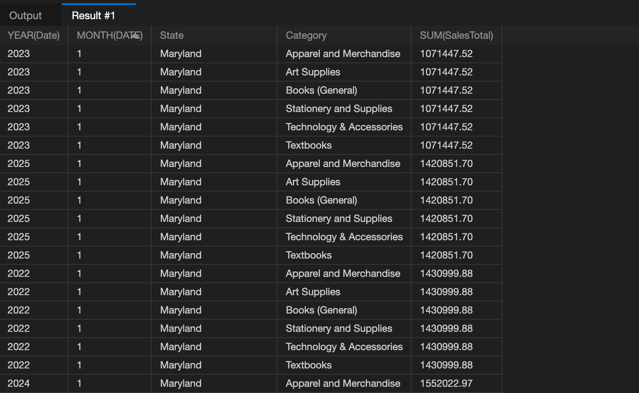
REVENUE BY YEAR
SELECT YEAR(Date), MONTH(DATE),State,Category, SUM(SalesTotal)
FROM Online_Sales,Management, Inventory_Categories
WHERE State = 'Maryland'
GROUP BY YEAR(Date), MONTH(DATE),State, Category
ORDER BY SUM(SalesTotal), YEAR(Date)
2022: 1238988.38
2023: 1298037.18
2024: 1552022.97
2025: 1660093.78

Slide 5
Region VS. State
State Revenue
SELECT State, SUM(SalesTotal)
FROM Management, Online_Sales
WHERE State = 'Maryland'
State(Maryland) : $68,004,827.05
Region : $ 272,019,308.20
Maryland counts for 25% (¼) of the region's sales.
Region Revenue
SELECT SUM(SalesTotal)
FROM Management, Online_Sales
WHERE Region = 'Northeast'

Slide 6
Transaction per month & average Transaction amount
SELECT Category, Date , AVG(SalesTotal), COUNT(*)
FROM Inventory_Categories JOIN Management JOIN Online_Sales
WHERE State = 'Maryland'
GROUP BY Category, Date
ORDER BY AVG(SalesTotal), Category
Row Labels | Count of # Category
Stationery and Supplies' | 167
Apparel and Merchandise' | 167
Art Supplies' | 167
Books (General)' | 167
Textbooks' | 166
Technology & Accessories' | 166
Grand Total | 1000

Slide 7
IN-STORE SALES PERFORMANCE
SELECT DISTINCT Transaction_Date, Store_ID,StoreLocation,State, AVG(Sale_Amount)
FROM Store_Locations JOIN Store_Sales
WHERE State = 'Maryland'
GROUP BY Transaction_Date, Store_ID, StoreLocation
ORDER BY AVG(Sale_Amount) ASC
Row Labels | Count of Transactions
Ridgely' | 112
Annapolis' | 111
Parkville' | 111
North Harford' | 111
Baltimore' | 111
Back River' | 111
Queen Anne's County' | 111
Germantown' | 111
Howard' | 110
Grand Total | 1000

Slide 8
RECOMMENDATIONS
My recommendation would be to add sales training to stores 903 which is the store that brings in the least averaged sales in the state of Maryland, 836, 850, and 816 to assess if training would increase the sales for these stores as a controlled group, then implement the developmental training to all stores if deemed successful.
We could also consider the supply chain that the location serves.
"How often do we receive items to stock?"
"What are the most profitable products?"
What are the least profitable products?"
" How can we raise sales for the least profitable products?"
These are some questions to be considered while assessing the shortage problem.

Slide 9
Thank you!

